Slide 1



Financial Highlights
As of October 31, 2021

Slide 2
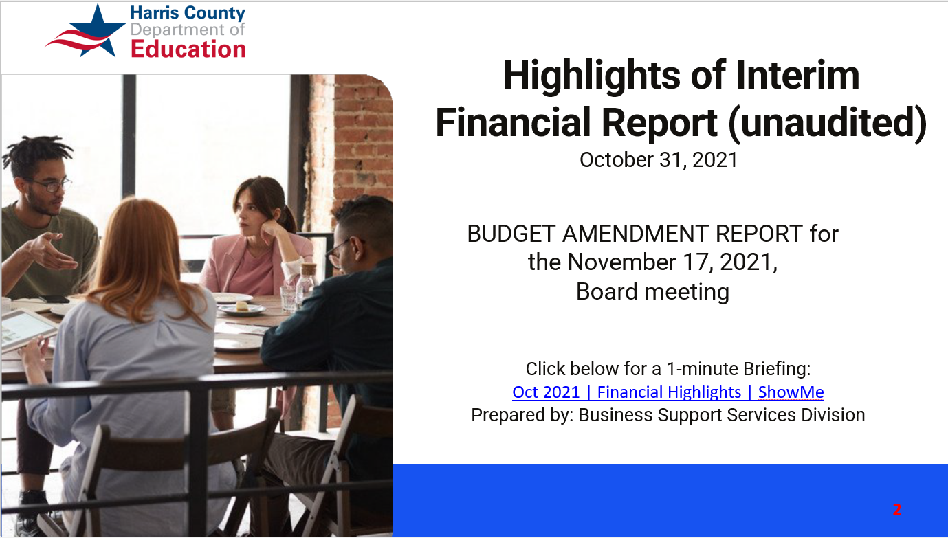

Highlights of Interim Financial Report (unaudited)
October 31, 2021
BUDGET AMENDMENT REPORT for the November 17, 2021,
Board meeting
Click below for a 1-minute Briefing:
Oct 2021 | Financial Highlights | ShowMe
Prepared by: Business Support Services Division

Slide 3

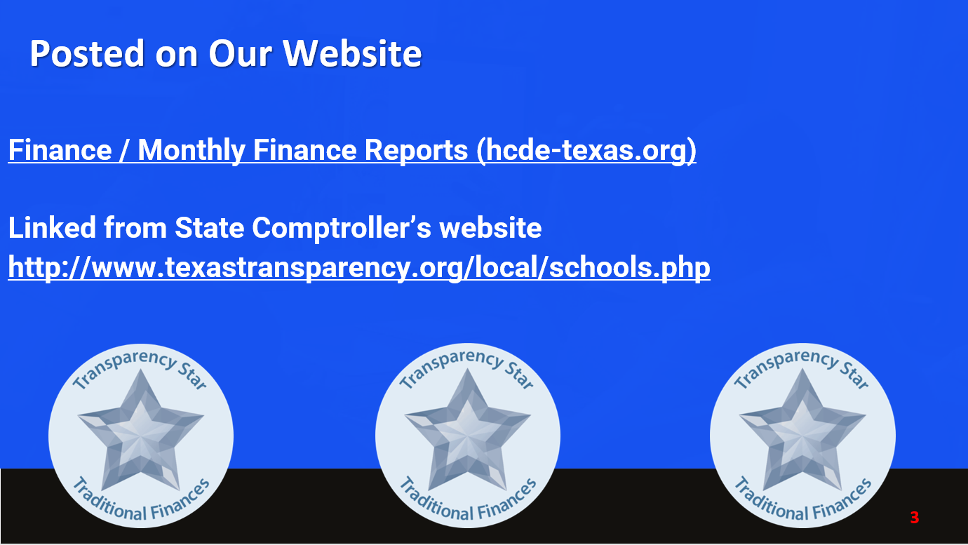


Posted on Our Website
Finance / Monthly Finance Reports (hcde-texas.org)
Linked from State Comptroller’s website
http://www.texastransparency.org/local/schools.php

Slide 4
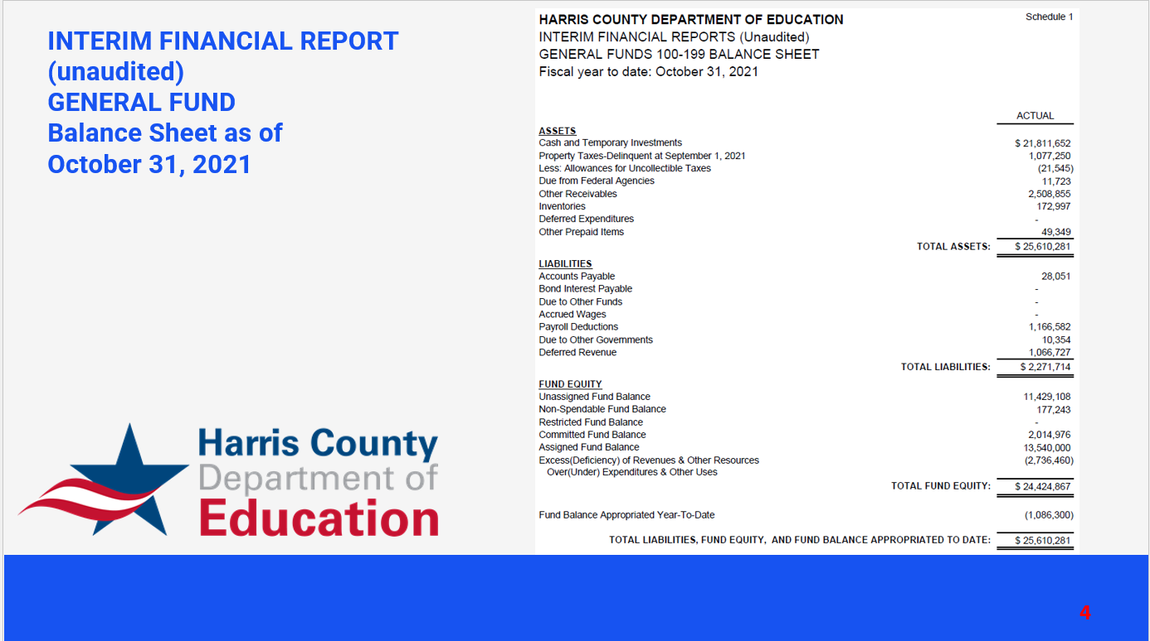
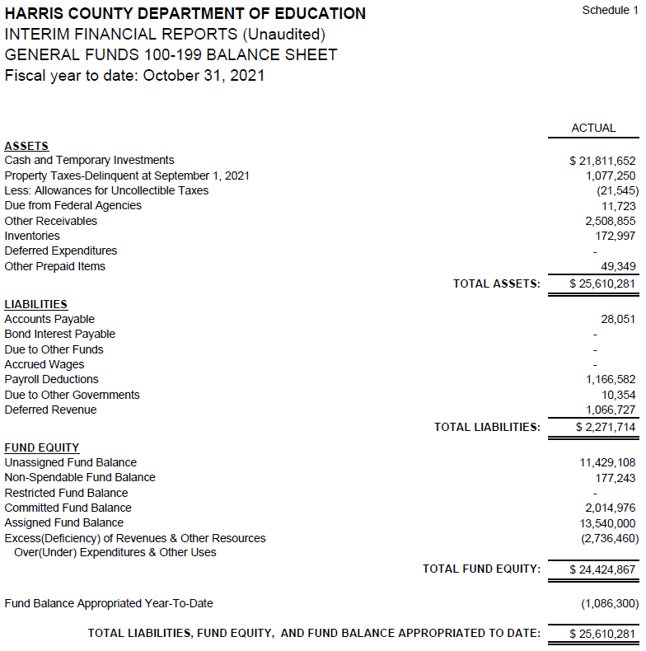

INTERIM FINANCIAL REPORT
(unaudited)
GENERAL FUND
Balance Sheet as of
October 31, 2021

Slide 5
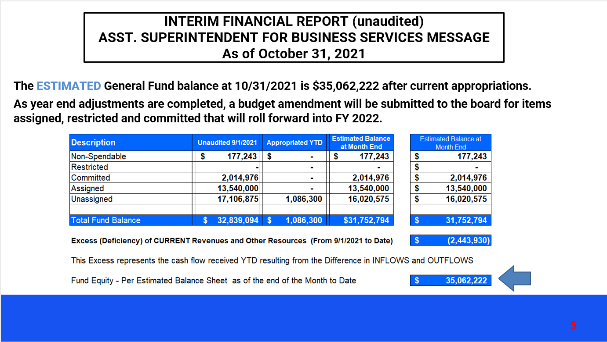
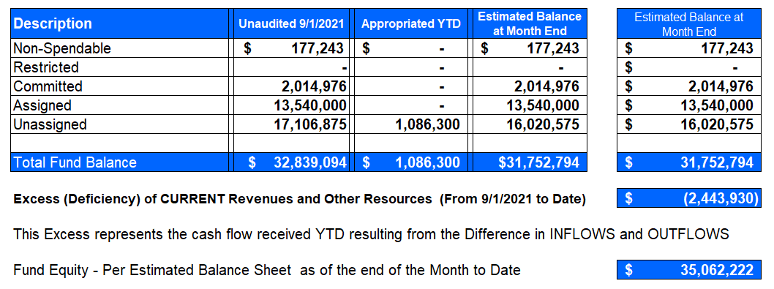
INTERIM FINANCIAL REPORT (unaudited)
ASST. SUPERINTENDENT FOR BUSINESS SERVICES MESSAGE
As of October 31, 2021
The ESTIMATED General Fund balance at 10/31/2021 is $35,062,222 after current appropriations.
As year end adjustments are completed, a budget amendment will be submitted to the board for items assigned, restricted and committed that will roll forward into FY 2022.

Slide 6
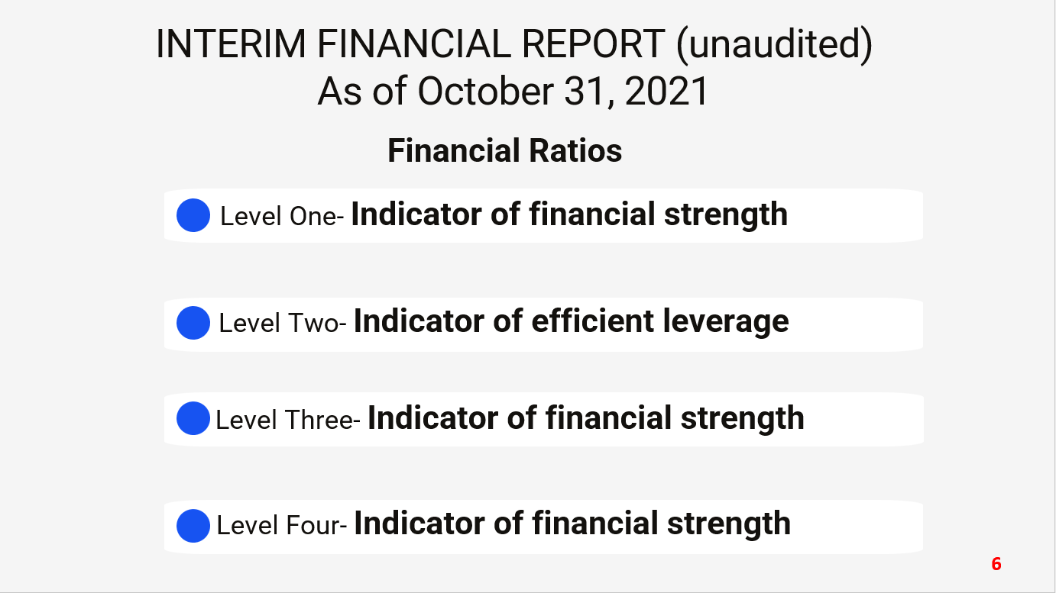

INTERIM FINANCIAL REPORT (unaudited)
As of October 31, 2021
Financial Ratios
Level One- Indicator of financial strength
Level Two- Indicator of efficient leverage
Level Three- Indicator of financial strength
Level Four- Indicator of financial strength

Slide 7

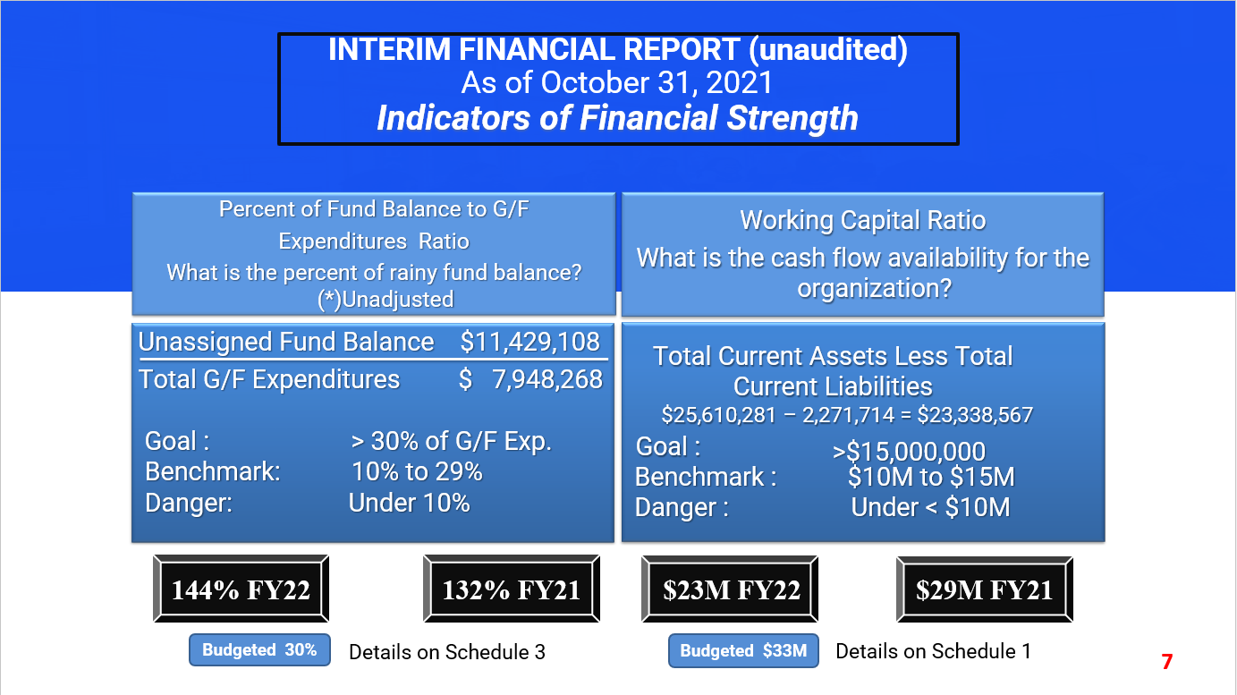
INTERIM FINANCIAL REPORT (unaudited)
As of October 31, 2021
Indicators of Financial Strength
Percent of Fund Balance to G/F
Expenditures Ratio
What is the percent of rainy fund balance? (*)Unadjusted
Working Capital Ratio
What is the cash flow availability for the organization?
Total Current Assets Less Total Current Liabilities
$25,610,281 – 2,271,714 = $23,338,567
Goal :
Unassigned Fund Balance $11,429,108
Total G/F Expenditures $ 7,948,268
Goal : > 30% of G/F Exp.
Benchmark: 10% to 29%
Danger: Under 10%
>$15,000,000
Benchmark : $10M to $15M
Danger : Under < $10M
144% FY22
132% FY21
$23M FY22
$29M FY21
Budgeted 30%
Details on Schedule 3
Budgeted $33M
Details on Schedule 1

Slide 8
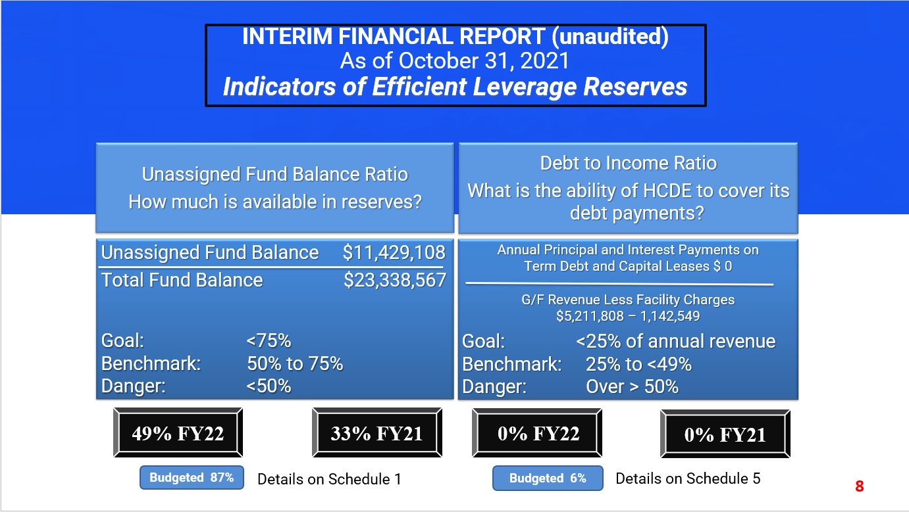
INTERIM FINANCIAL REPORT (unaudited)
As of October 31, 2021
Indicators of Efficient Leverage Reserves
Unassigned Fund Balance Ratio
How much is available in reserves?
Debt to Income Ratio
What is the ability of HCDE to cover its debt payments?
Unassigned Fund Balance $11,429,108
Total Fund Balance $23,338,567
Annual Principal and Interest Payments on
Term Debt and Capital Leases $ 0
G/F Revenue Less Facility Charges
$5,211,808 – 1,142,549
Goal: <75%
Benchmark: 50% to 75%
Danger: <50%
Goal: <25% of annual revenue
Benchmark: 25% to <49%
Danger: Over > 50%
49% FY22
33% FY21
0% FY22
0% FY21
Budgeted 87%
Details on Schedule 1
Budgeted 6%
Details on Schedule 5

Slide 9
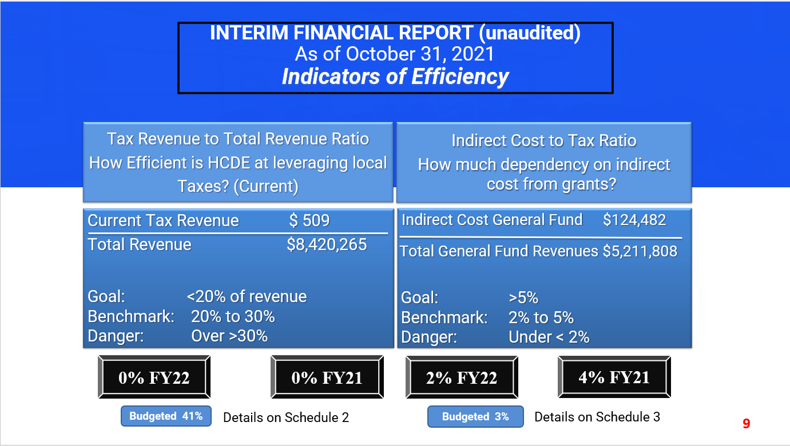
INTERIM FINANCIAL REPORT (unaudited)
As of October 31, 2021
Indicators of Efficiency
Tax Revenue to Total Revenue Ratio
How Efficient is HCDE at leveraging local
Taxes? (Current)
Indirect Cost to Tax Ratio
How much dependency on indirect cost from grants?
Current Tax Revenue $ 509
Total Revenue $8,420,265
Indirect Cost General Fund $124,482
Total General Fund Revenues $5,211,808
Goal: <20% of revenue
Benchmark: 20% to 30%
Danger: Over >30%
Goal: >5%
Benchmark: 2% to 5%
Danger: Under < 2%
0% FY22
0% FY21
2% FY22
4% FY21
Budgeted 41%
Details on Schedule 2
Budgeted 3%
Details on Schedule 3

Slide 10
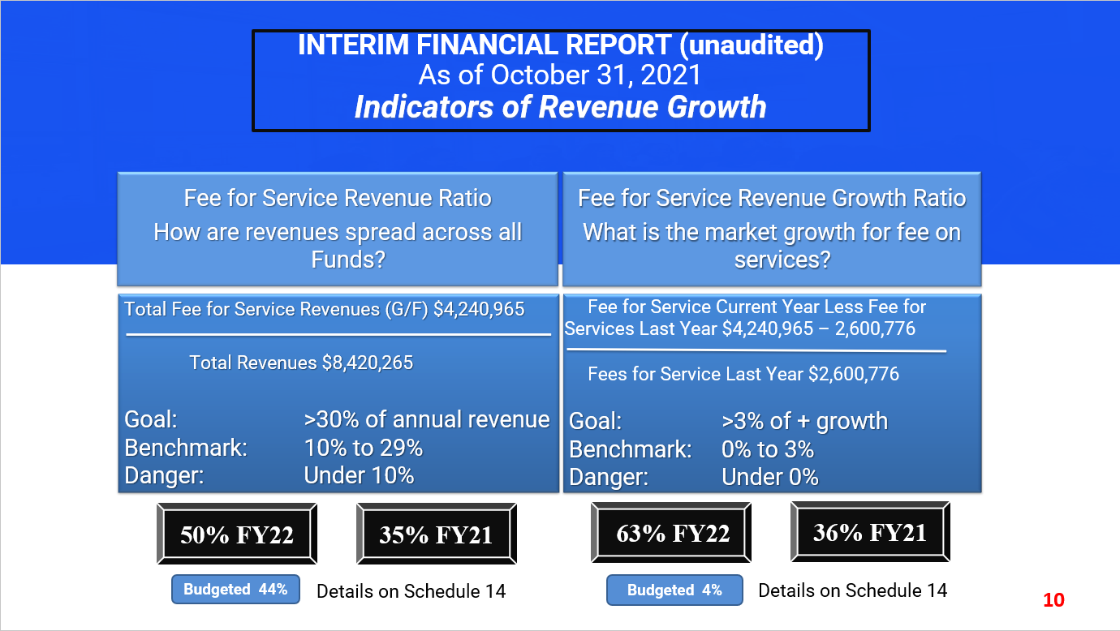
INTERIM FINANCIAL REPORT (unaudited)
As of October 31, 2021
Indicators of Revenue Growth
Fee for Service Revenue Ratio
How are revenues spread across all Funds?
Fee for Service Revenue Growth Ratio
What is the market growth for fee on services?
Total Fee for Service Revenues (G/F) $4,240,965
Total Revenues $8,420,265
Fee for Service Current Year Less Fee for Services Last Year $4,240,965 – 2,600,776
Fees for Service Last Year $2,600,776
Goal: >30% of annual revenue Benchmark: 10% to 29%
Danger: Under 10%
Goal: >3% of + growth
Benchmark: 0% to 3%
Danger: Under 0%
50% FY22
35% FY21
63% FY22
36% FY21
Budgeted 44%
Details on Schedule 14
Budgeted 4%
Details on Schedule 14

Slide 11
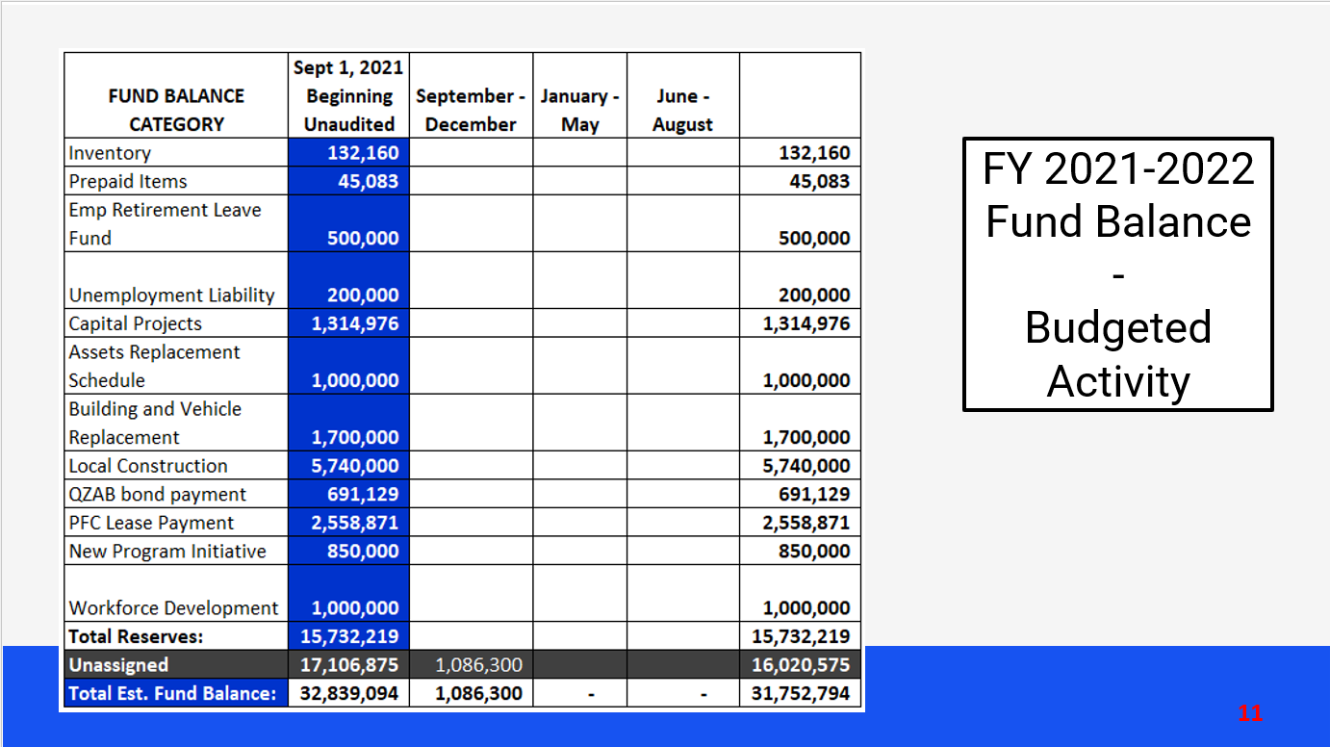
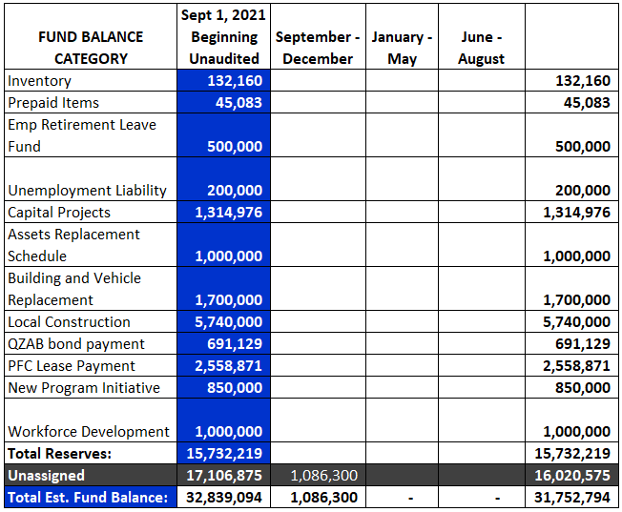
FY 2021-2022
Fund Balance
-
Budgeted Activity

Slide 12
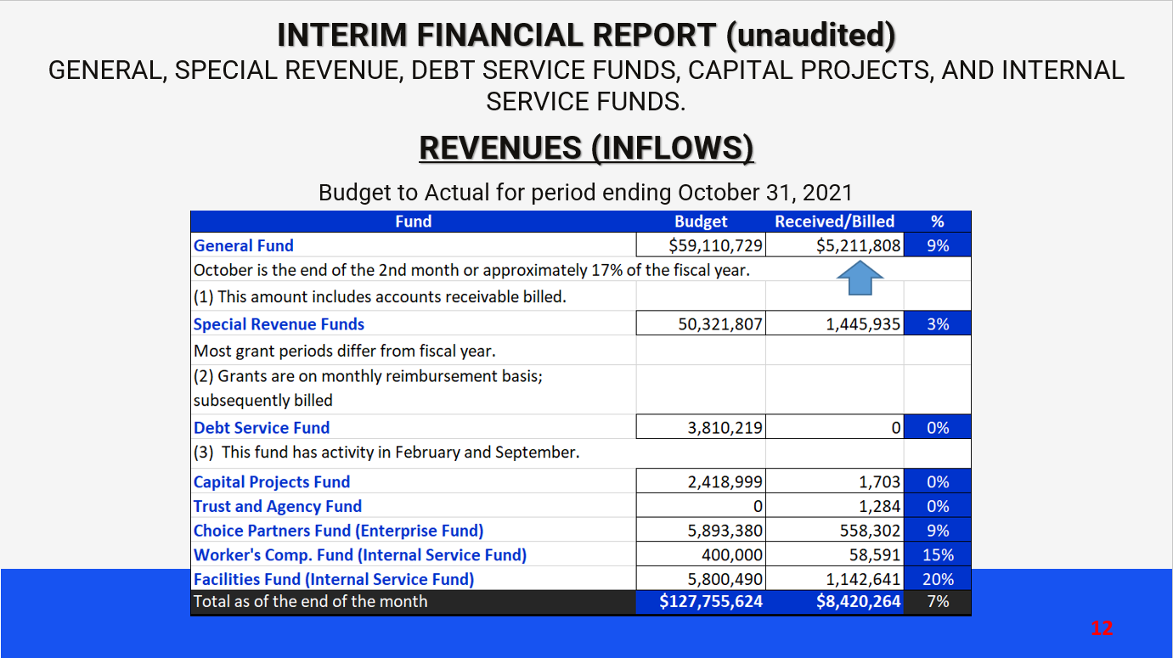
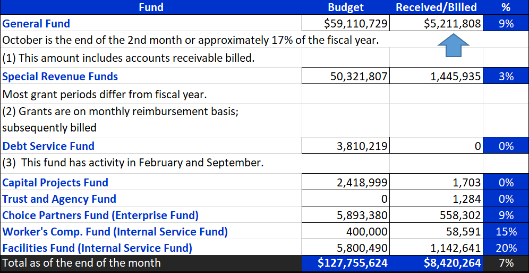
INTERIM FINANCIAL REPORT (unaudited)
GENERAL, SPECIAL REVENUE, DEBT SERVICE FUNDS, CAPITAL PROJECTS, AND INTERNAL SERVICE FUNDS.
REVENUES (INFLOWS)
Budget to Actual for period ending October 31, 2021

Slide 13
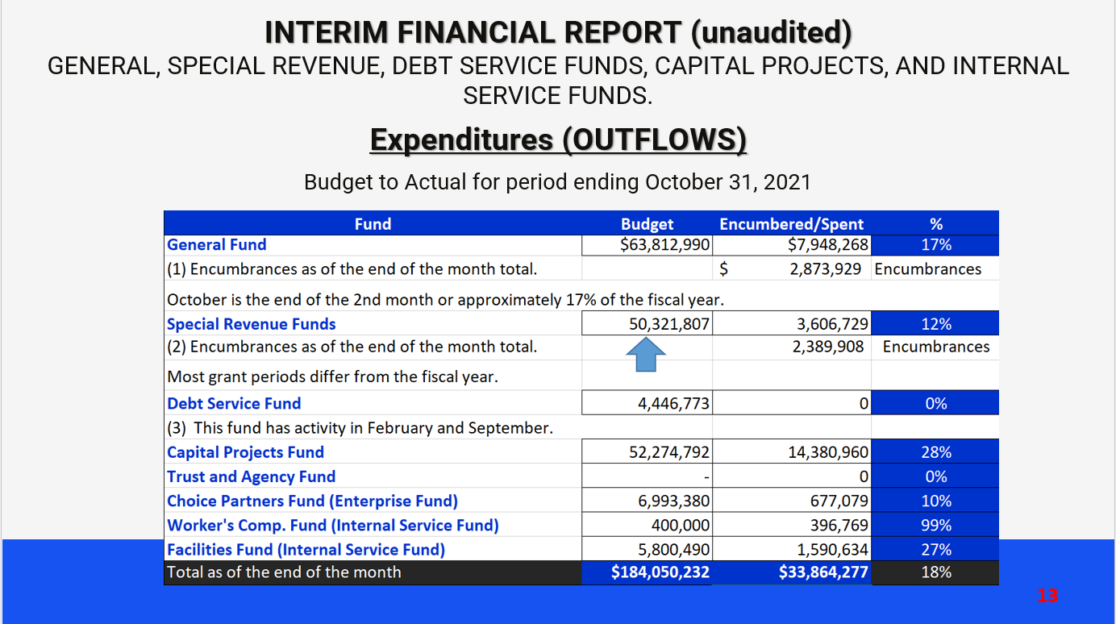
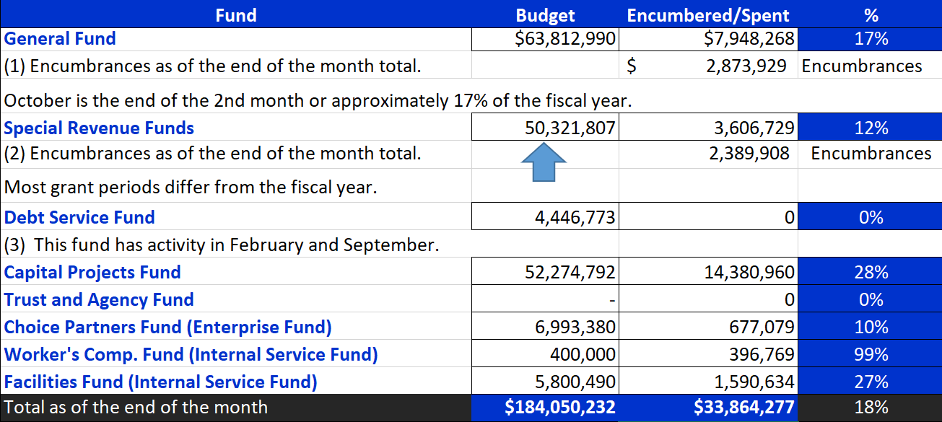
INTERIM FINANCIAL REPORT (unaudited)
GENERAL, SPECIAL REVENUE, DEBT SERVICE FUNDS, CAPITAL PROJECTS, AND INTERNAL SERVICE FUNDS.
Expenditures (OUTFLOWS)
Budget to Actual for period ending October 31, 2021

Slide 14
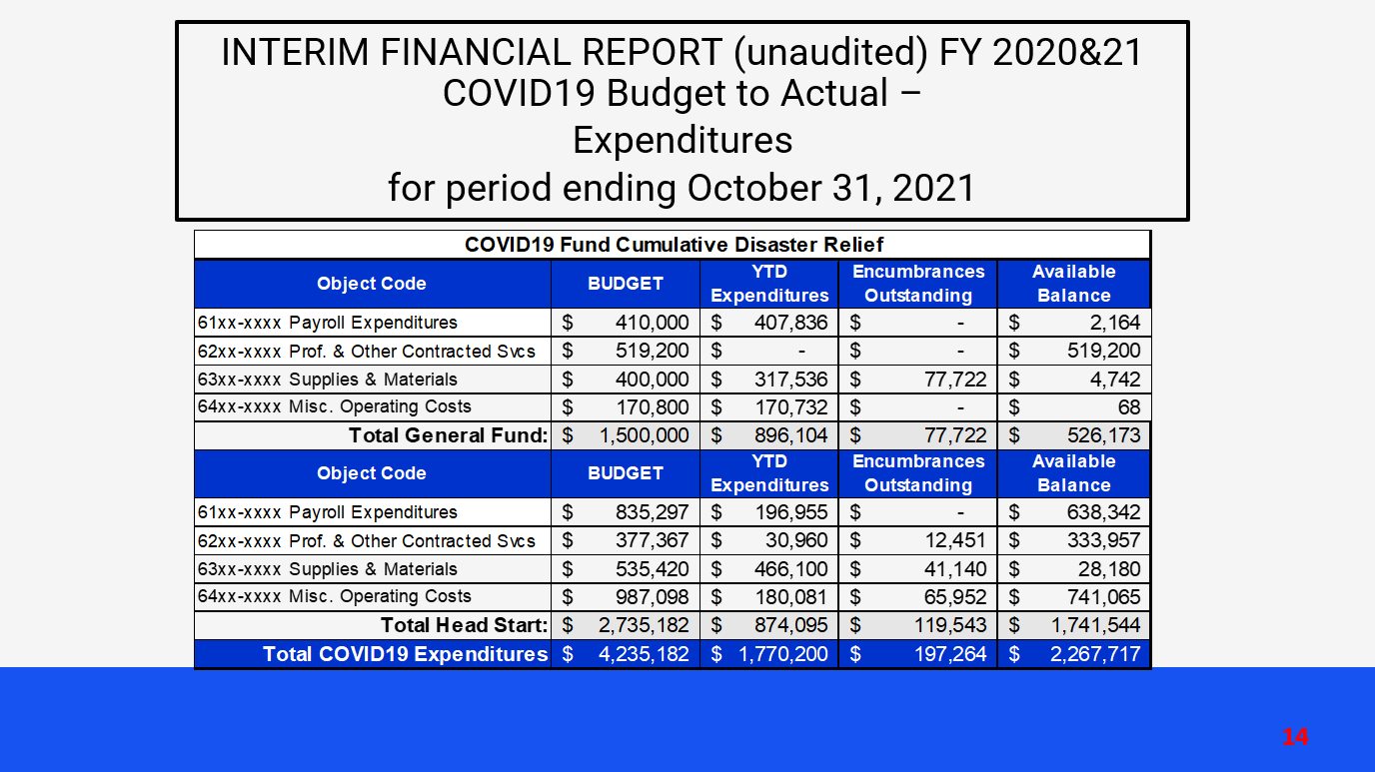
INTERIM FINANCIAL REPORT (unaudited) FY 2020&21 COVID19 Budget to Actual –
Expenditures
for period ending October 31, 2021

Slide 15
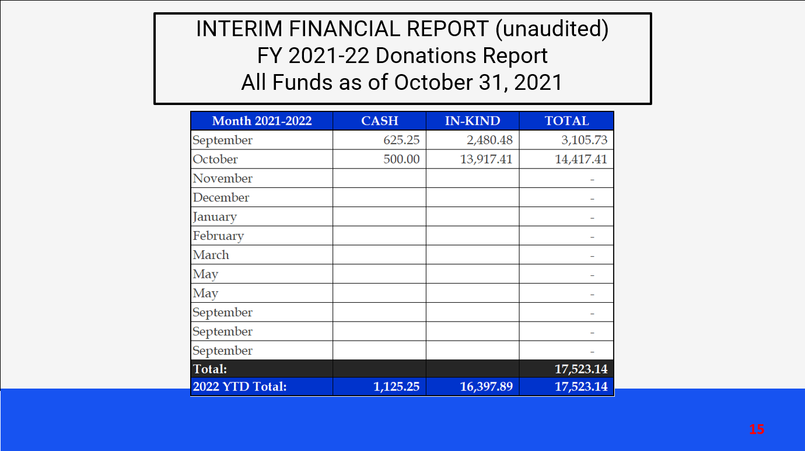
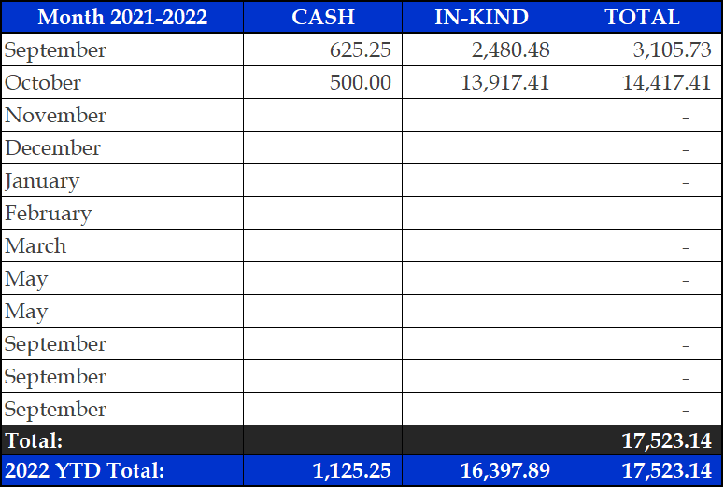
INTERIM FINANCIAL REPORT (unaudited)
FY 2021-22 Donations Report
All Funds as of October 31, 2021

Slide 16
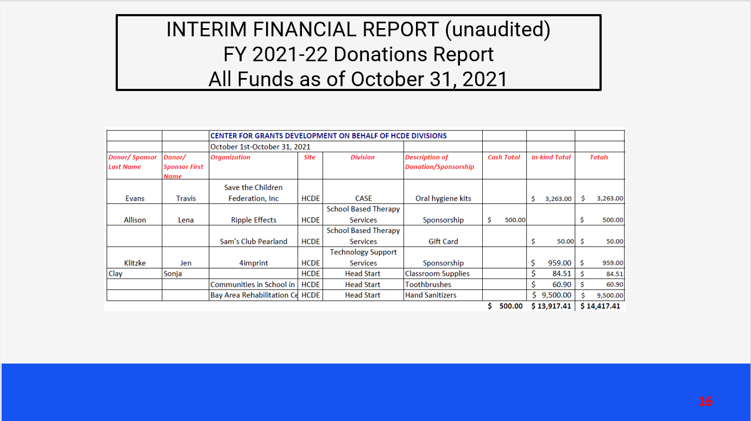
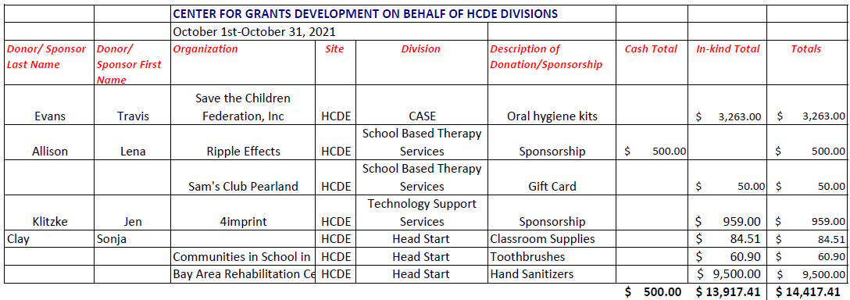
INTERIM FINANCIAL REPORT (unaudited)
FY 2021-22 Donations Report
All Funds as of October 31, 2021

Slide 17
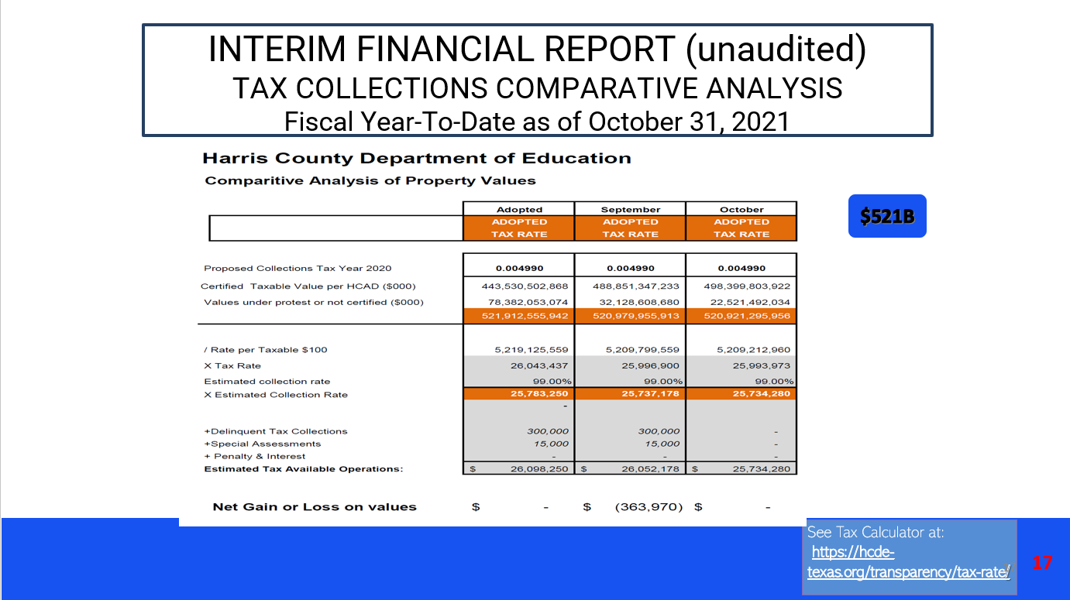
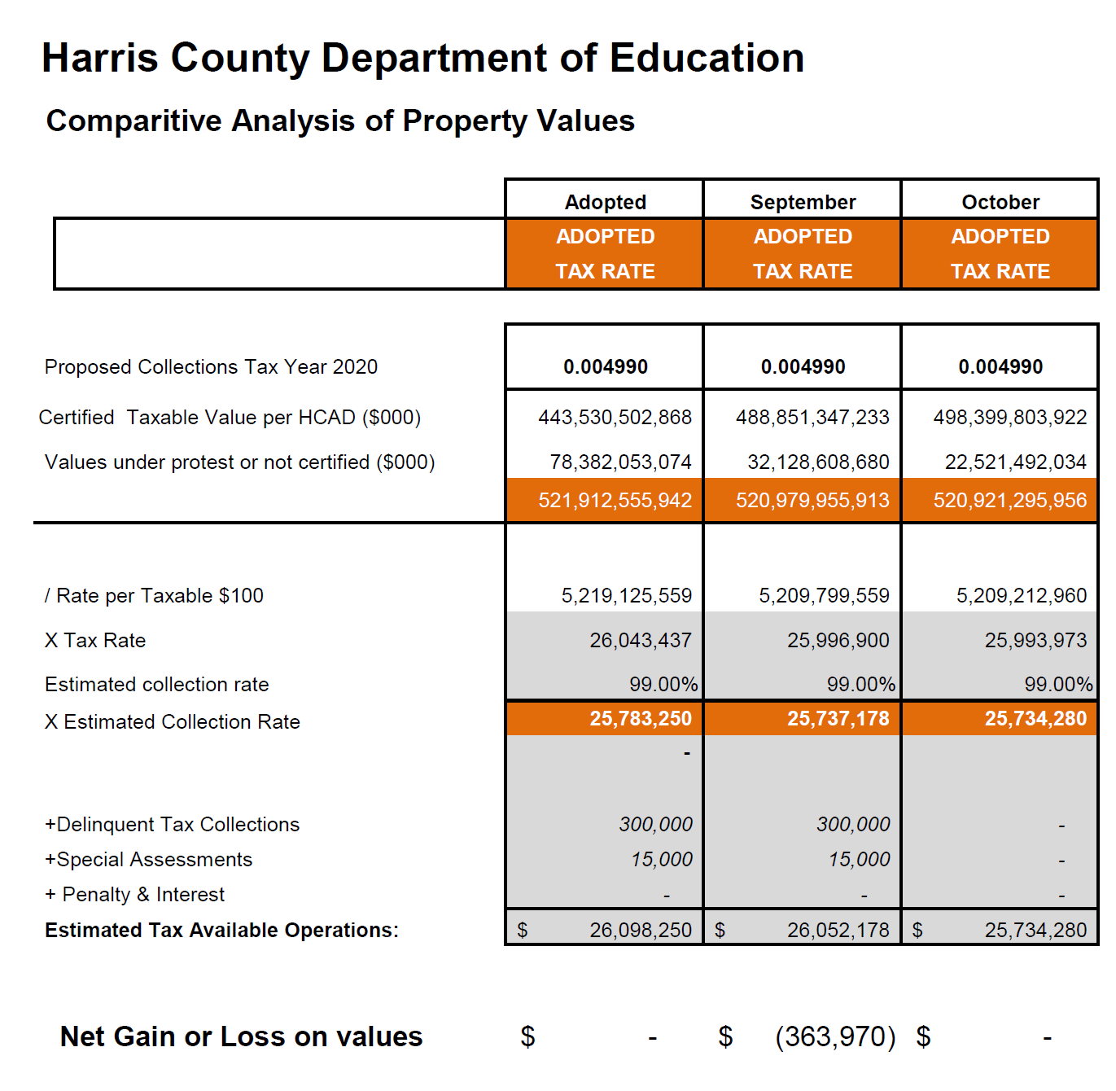
INTERIM FINANCIAL REPORT (unaudited)
TAX COLLECTIONS COMPARATIVE ANALYSIS
Fiscal Year-To-Date as of October 31, 2021
$521B
See Tax Calculator at:
https://hcde-texas.org/transparency/tax-rate/
17

Slide 18
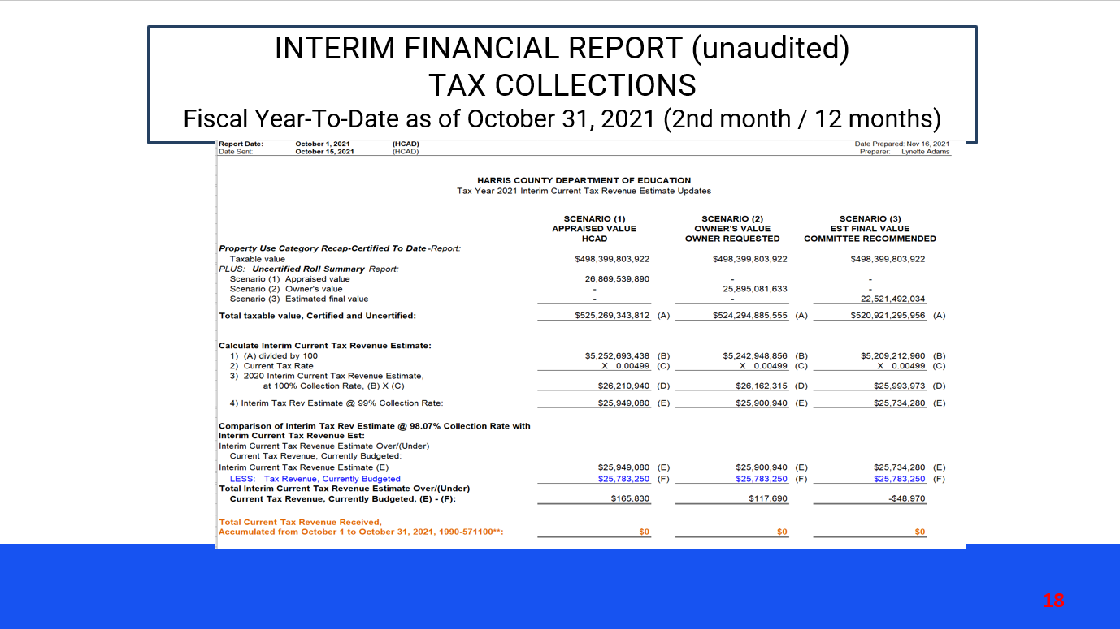
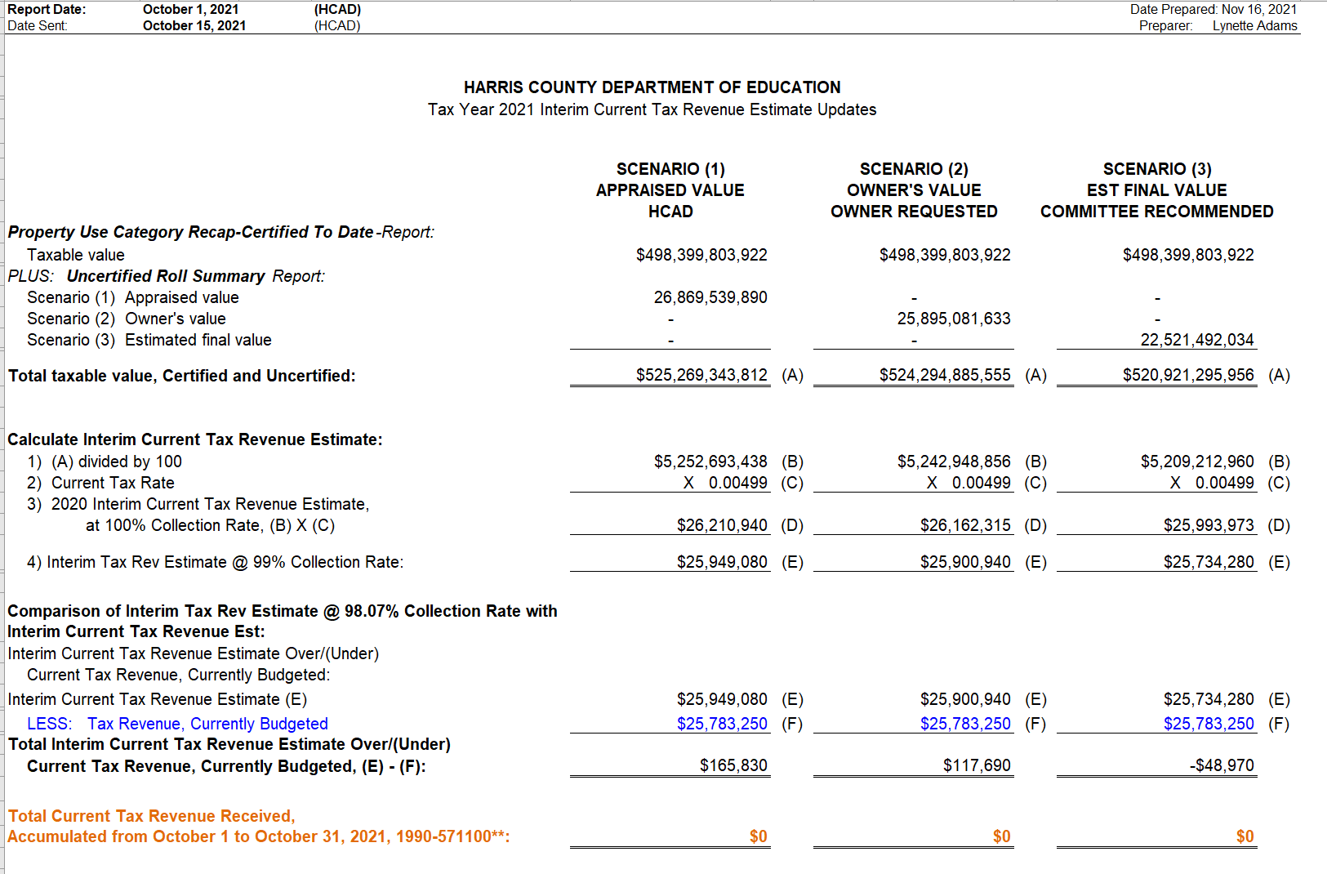
INTERIM FINANCIAL REPORT (unaudited)
TAX COLLECTIONS
Fiscal Year-To-Date as of October 31, 2021 (2nd month / 12 months)

Slide 19
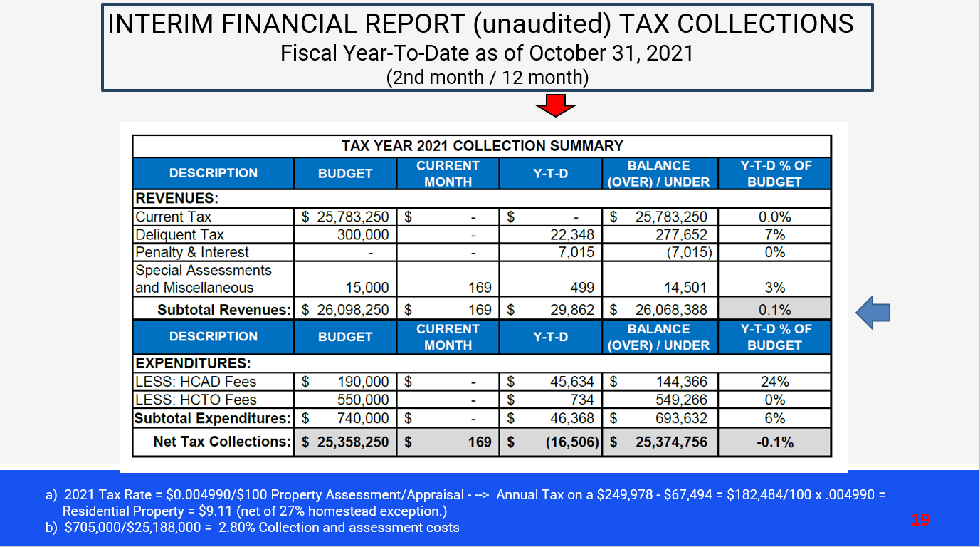
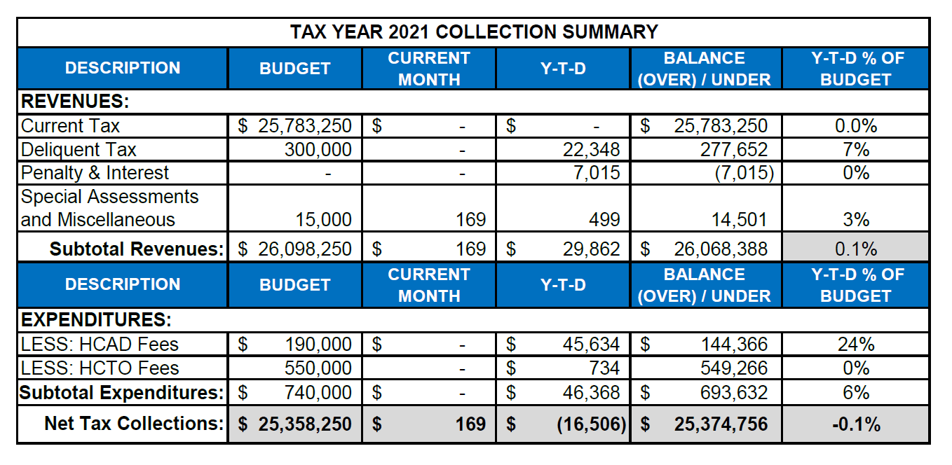
INTERIM FINANCIAL REPORT (unaudited) TAX COLLECTIONS
Fiscal Year-To-Date as of October 31, 2021
(2nd month / 12 month)
a) 2021 Tax Rate = $0.004990/$100 Property Assessment/Appraisal - --> Annual Tax on a $249,978 - $67,494 = $182,484/100 x .004990 =
Residential Property = $9.11 (net of 27% homestead exception.)
b) $705,000/$25,188,000 = 2.80% Collection and assessment costs

Slide 20
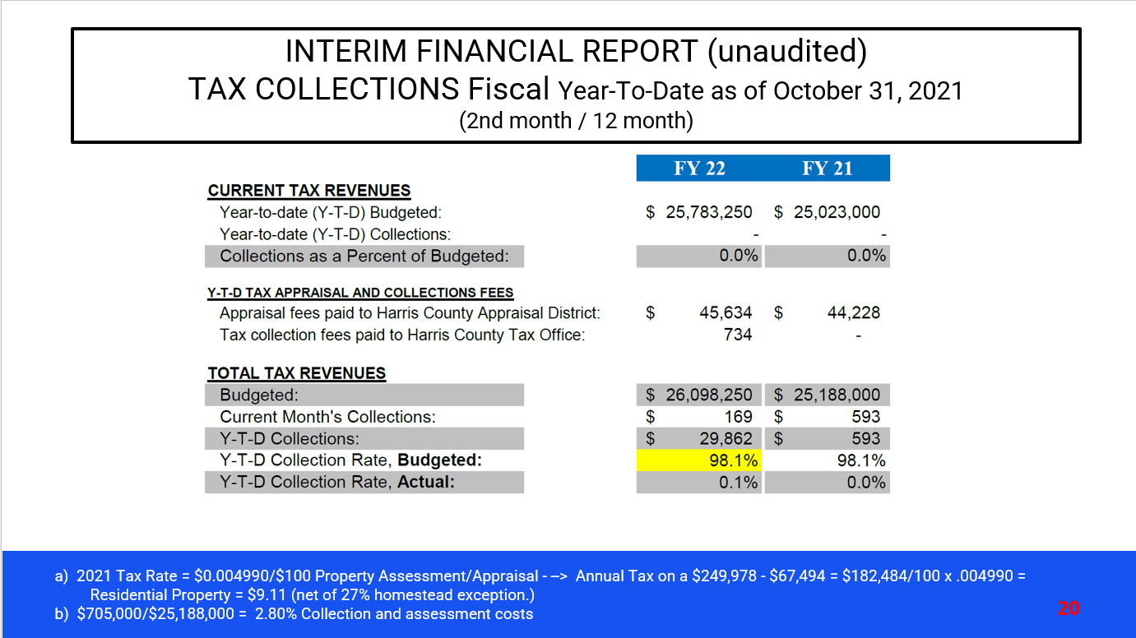
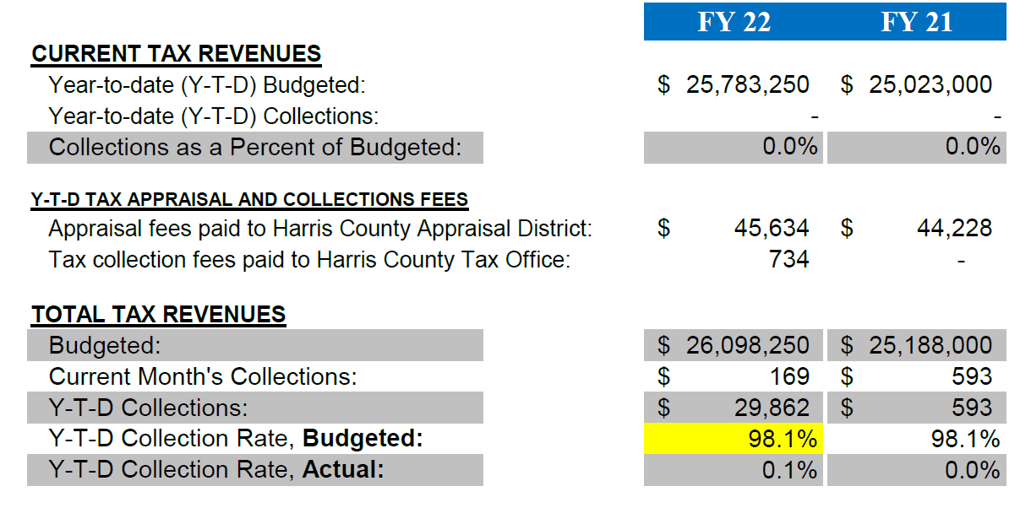
INTERIM FINANCIAL REPORT (unaudited)
TAX COLLECTIONS Fiscal Year-To-Date as of October 31, 2021
(2nd month / 12 month)
a) 2021 Tax Rate = $0.004990/$100 Property Assessment/Appraisal - --> Annual Tax on a $249,978 - $67,494 = $182,484/100 x .004990 =
Residential Property = $9.11 (net of 27% homestead exception.)
b) $705,000/$25,188,000 = 2.80% Collection and assessment costs

Slide 21
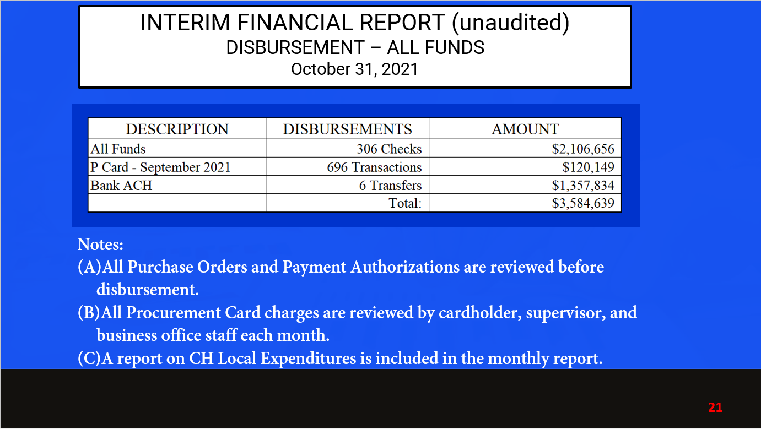

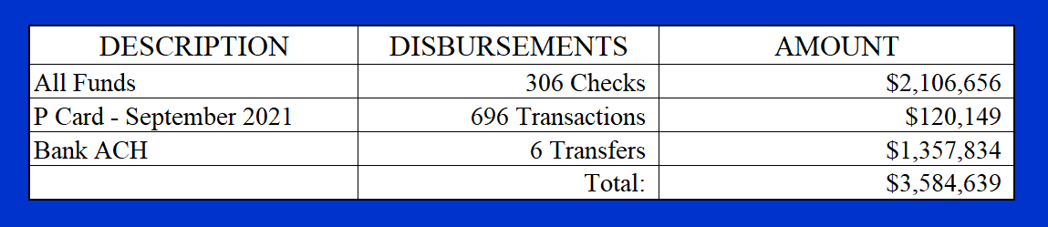
INTERIM FINANCIAL REPORT (unaudited)
DISBURSEMENT – ALL FUNDS
October 31, 2021
Notes:
All Purchase Orders and Payment Authorizations are reviewed before disbursement.
All Procurement Card charges are reviewed by cardholder, supervisor, and business office staff each month.
A report on CH Local Expenditures is included in the monthly report.

Slide 22
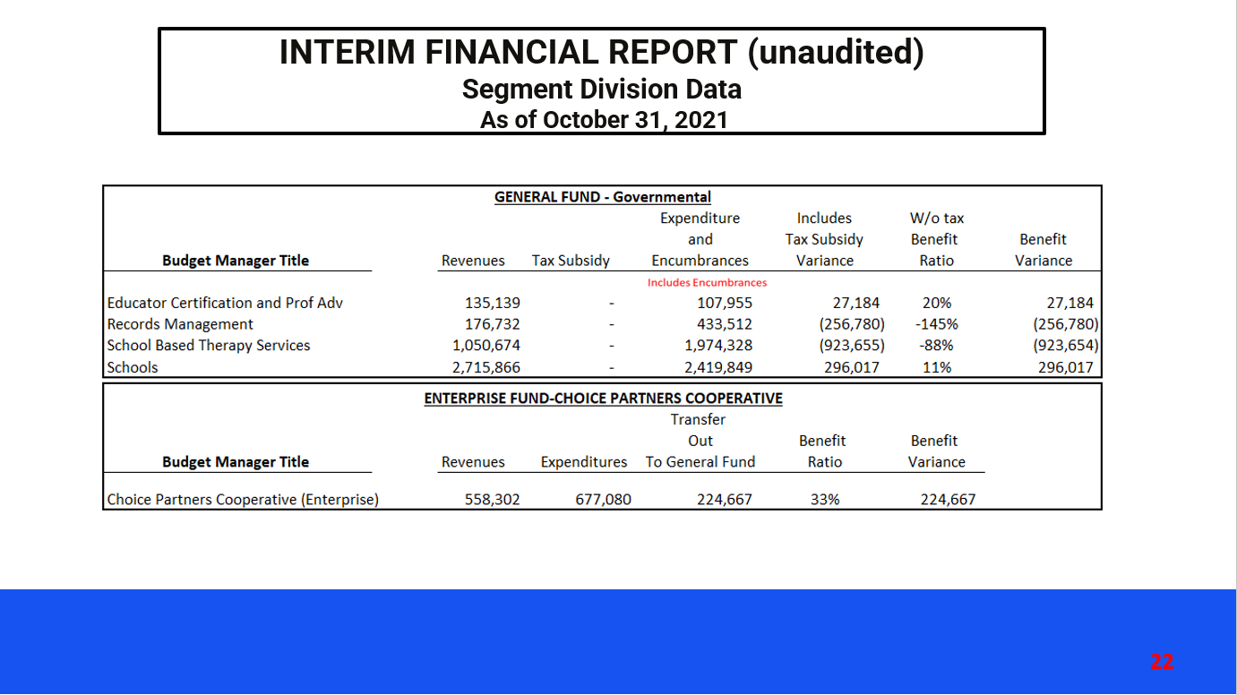
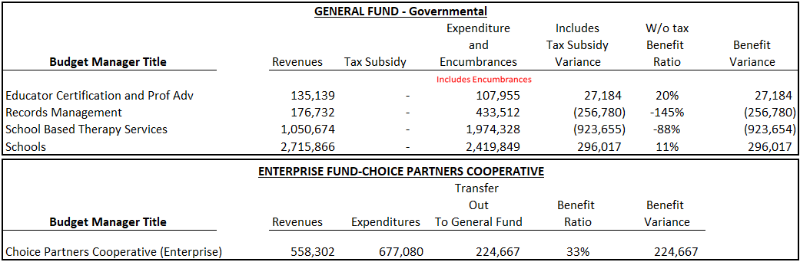
INTERIM FINANCIAL REPORT (unaudited)
Segment Division Data
As of October 31, 2021

Slide 23
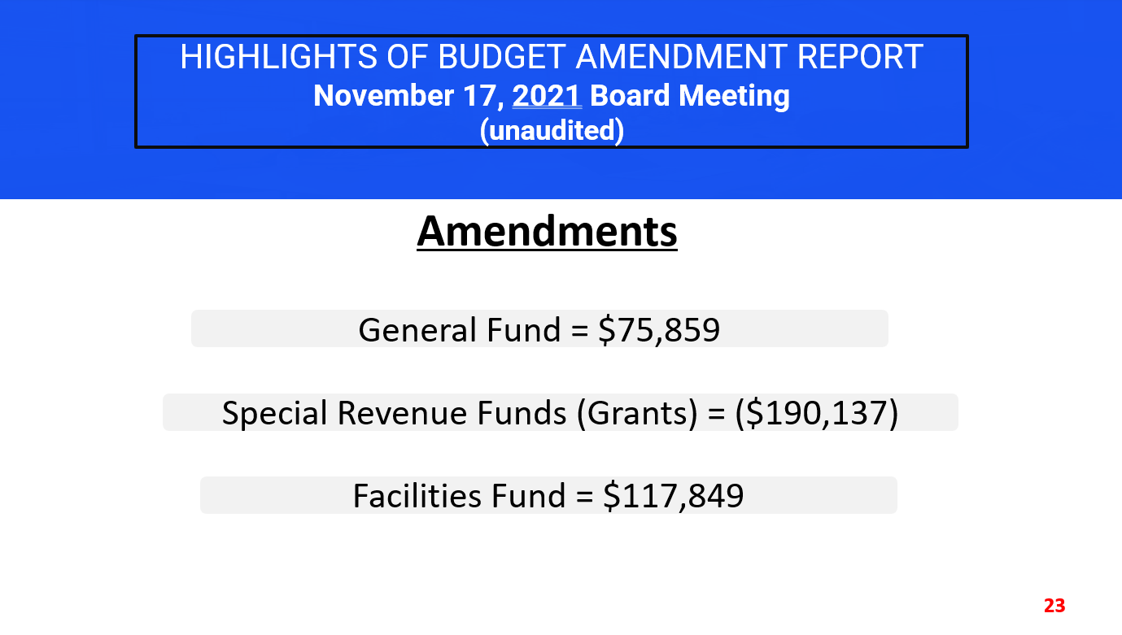
HIGHLIGHTS OF BUDGET AMENDMENT REPORT
November 17, 2021 Board Meeting
(unaudited)
Amendments
General Fund = $75,859
Special Revenue Funds (Grants) = ($190,137)
Facilities Fund = $117,849

Slide 24
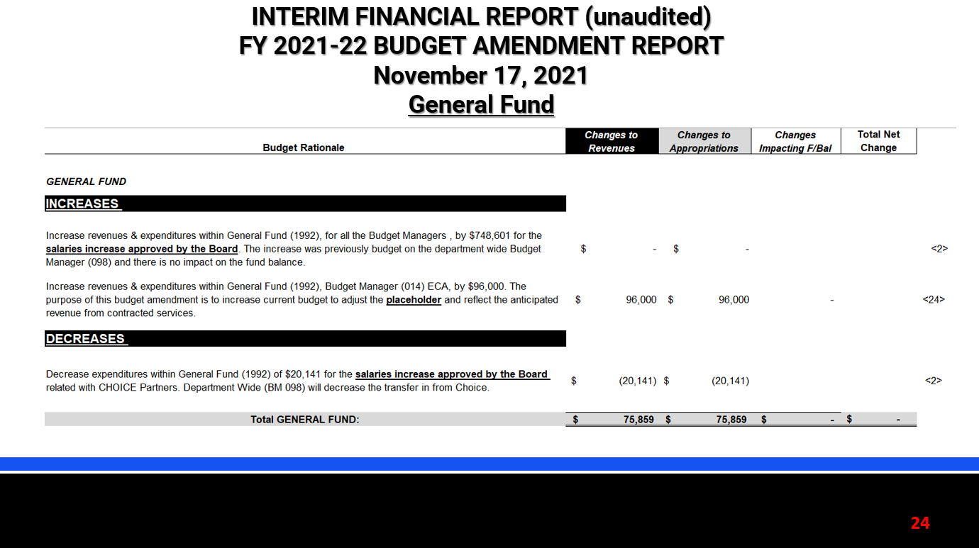
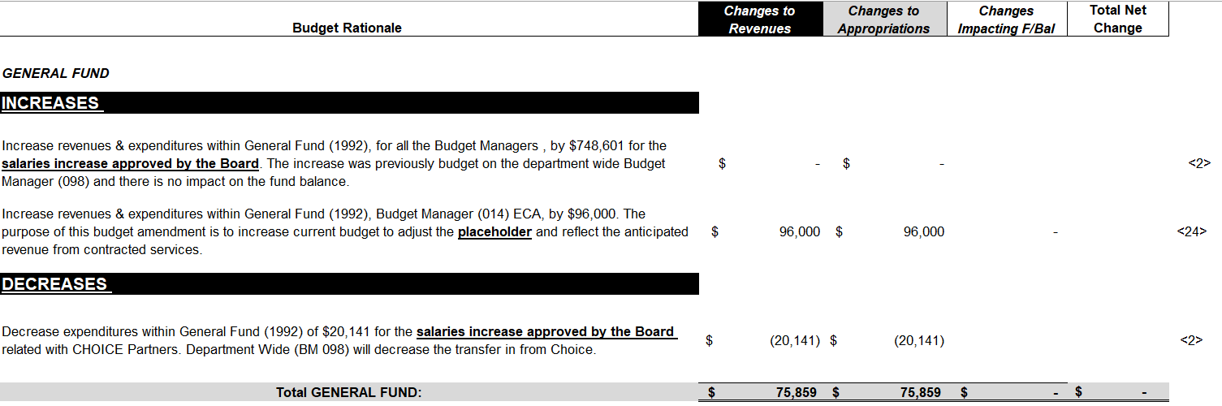
INTERIM FINANCIAL REPORT (unaudited)
FY 2021-22 BUDGET AMENDMENT REPORT
November 17, 2021
General Fund

Slide 25
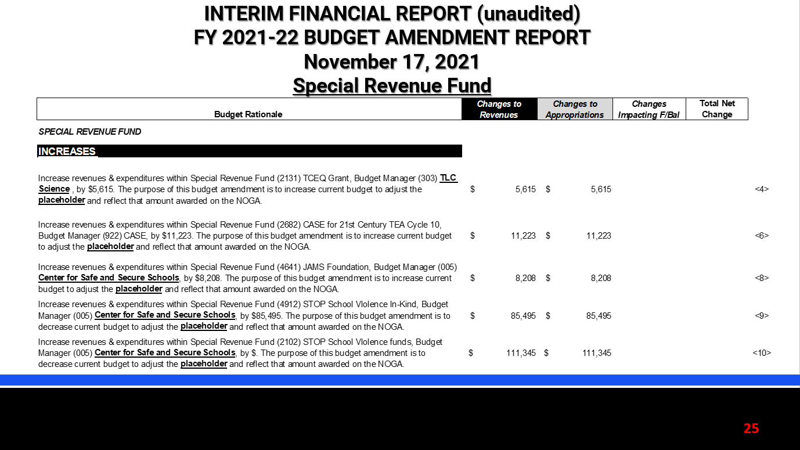
INTERIM FINANCIAL REPORT (unaudited)
FY 2021-22 BUDGET AMENDMENT REPORT
November 17, 2021
Special Revenue Fund

Slide 26
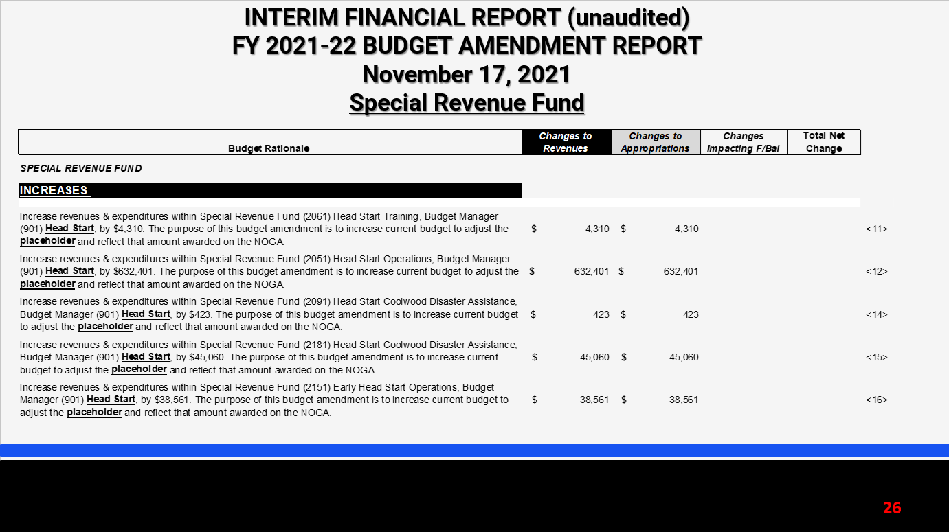
INTERIM FINANCIAL REPORT (unaudited)
FY 2021-22 BUDGET AMENDMENT REPORT
November 17, 2021
Special Revenue Fund

Slide 27
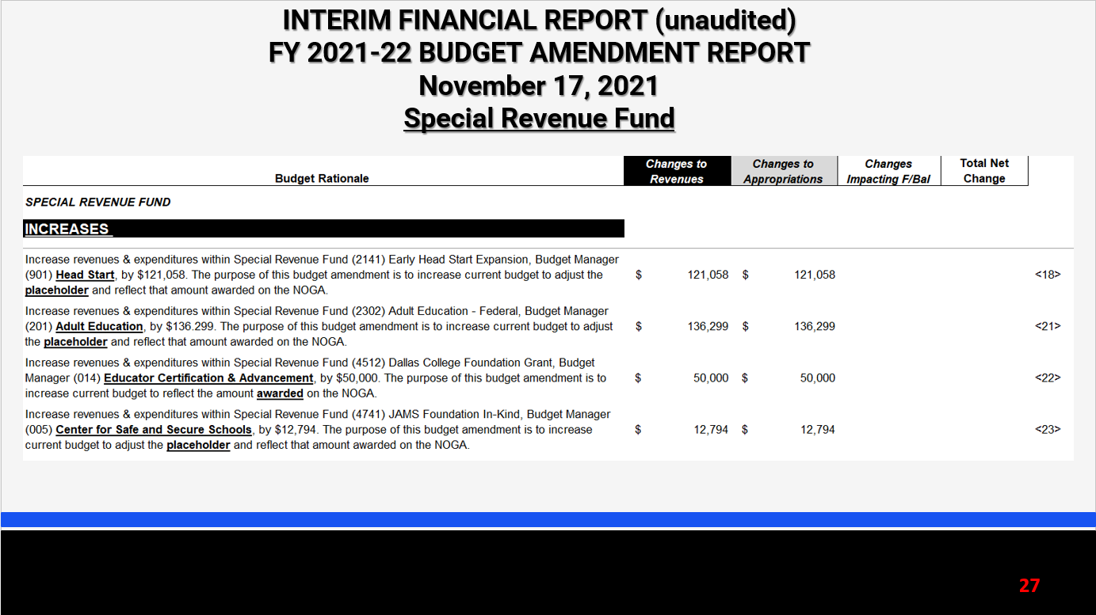
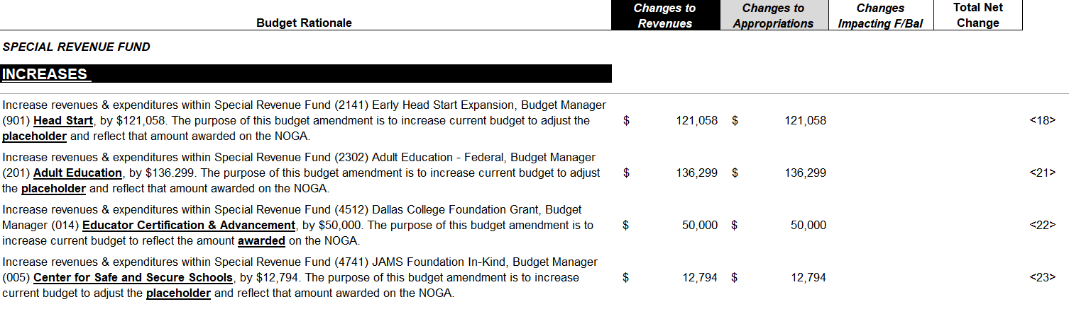
INTERIM FINANCIAL REPORT (unaudited)
FY 2021-22 BUDGET AMENDMENT REPORT
November 17, 2021
Special Revenue Fund

Slide 28
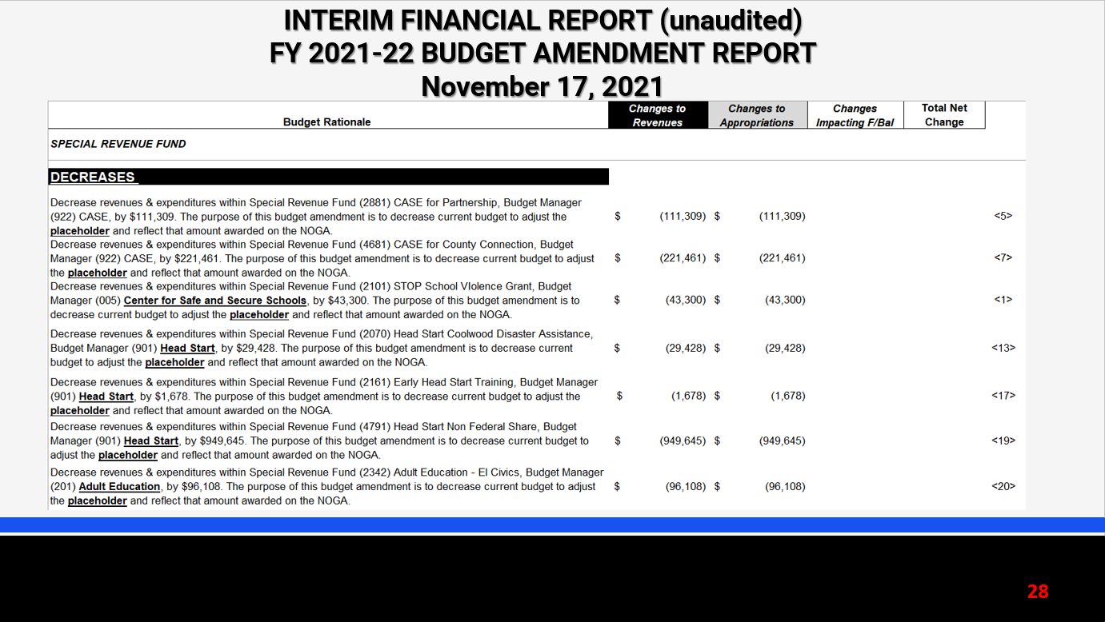
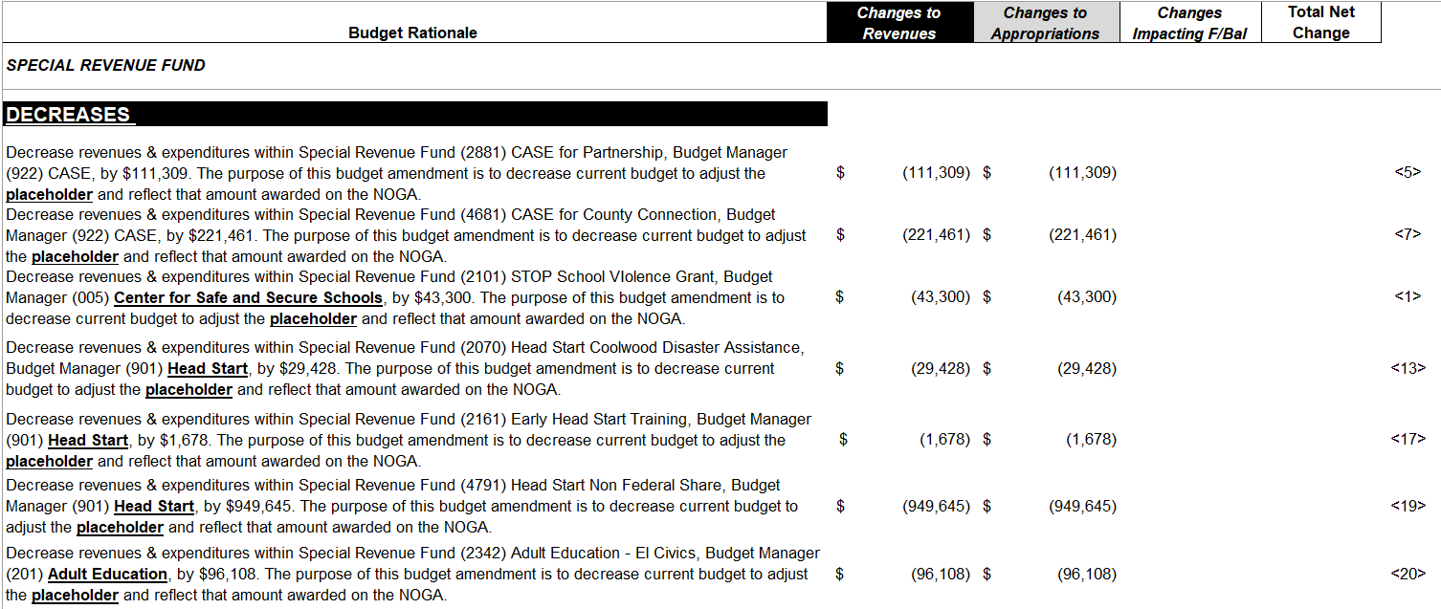
INTERIM FINANCIAL REPORT (unaudited)
FY 2021-22 BUDGET AMENDMENT REPORT
November 17, 2021
Special Revenue Fund

Slide 29
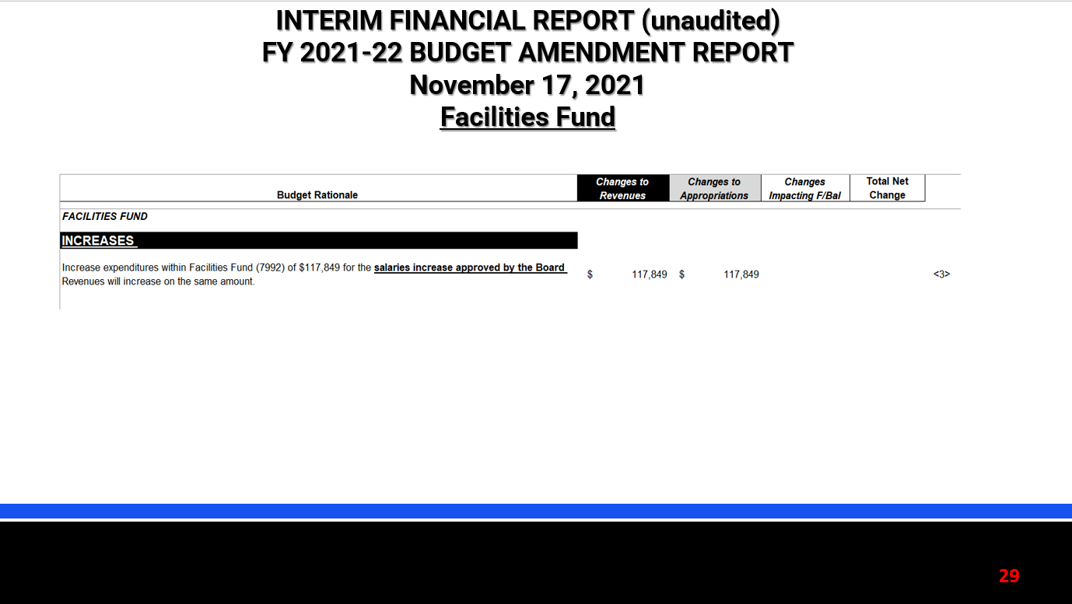
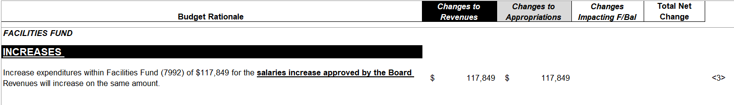
INTERIM FINANCIAL REPORT (unaudited)
FY 2021-22 BUDGET AMENDMENT REPORT
November 17, 2021
Facilities Fund

Slide 30


Education Foundation Update
October 31, 2021

Slide 31
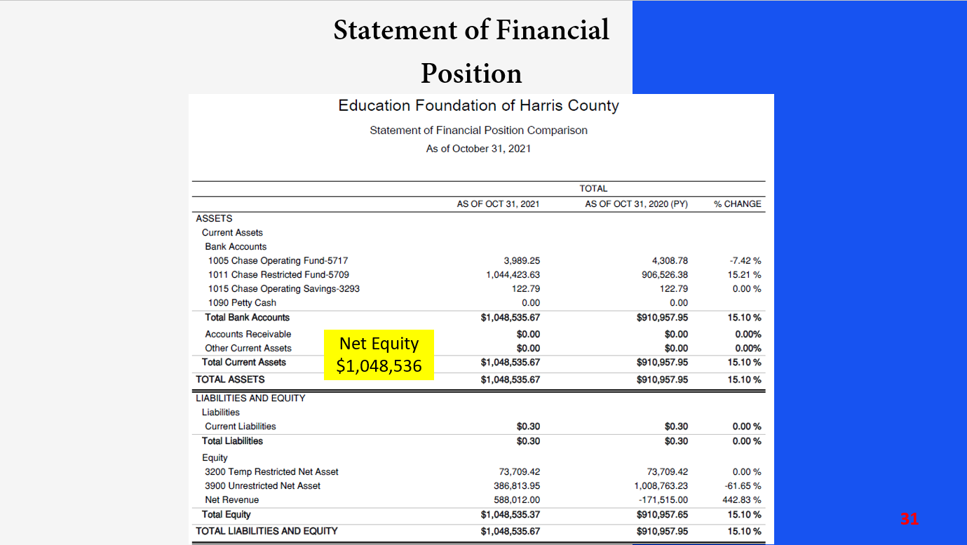
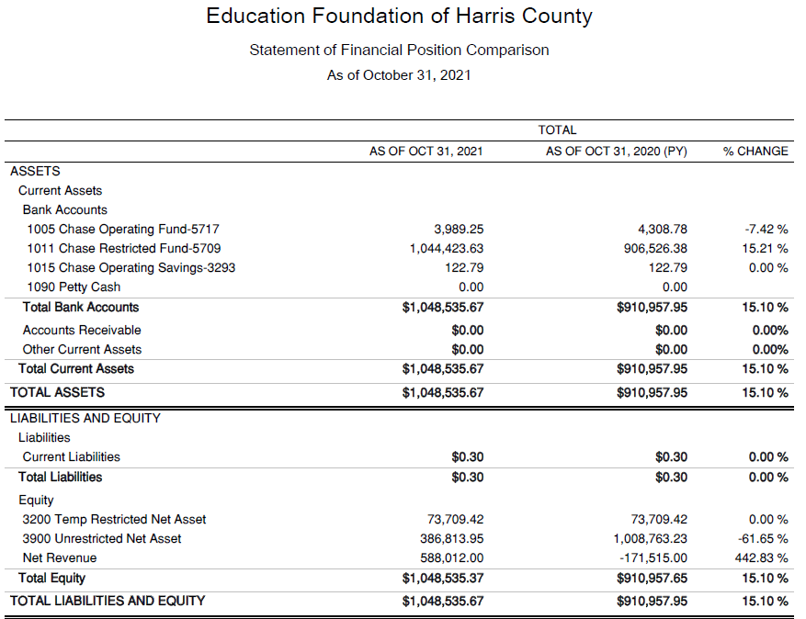
Statement of Financial Position
Net Equity $1,048,536

Slide 32
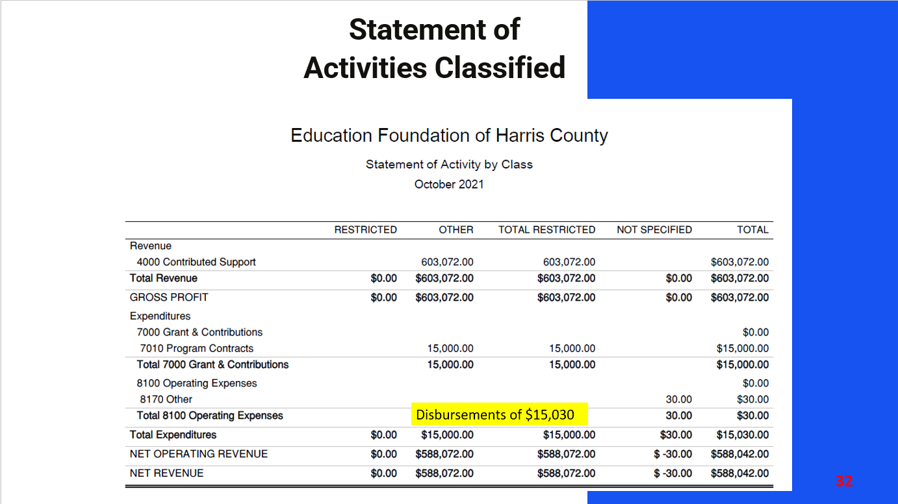
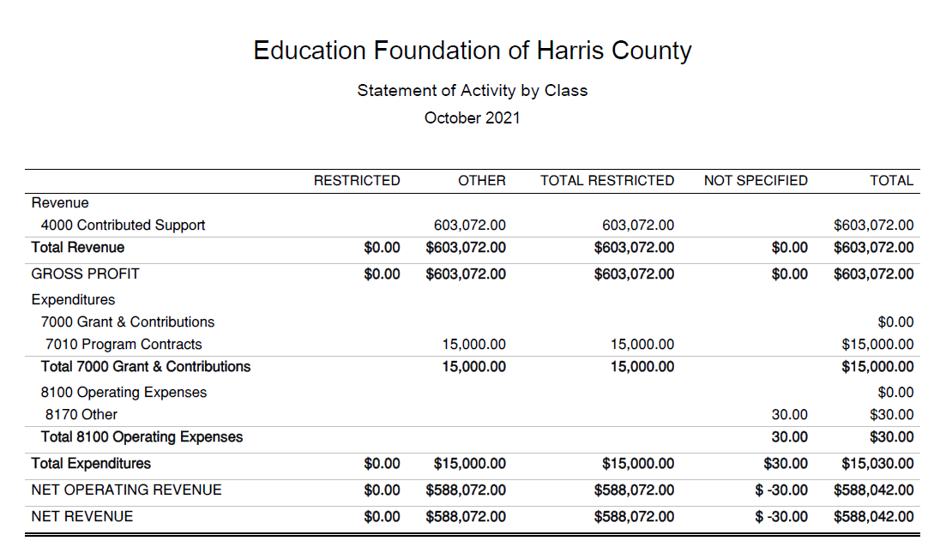
Statement of Activities Classified
.
Disbursements of $15,030

Slide 33
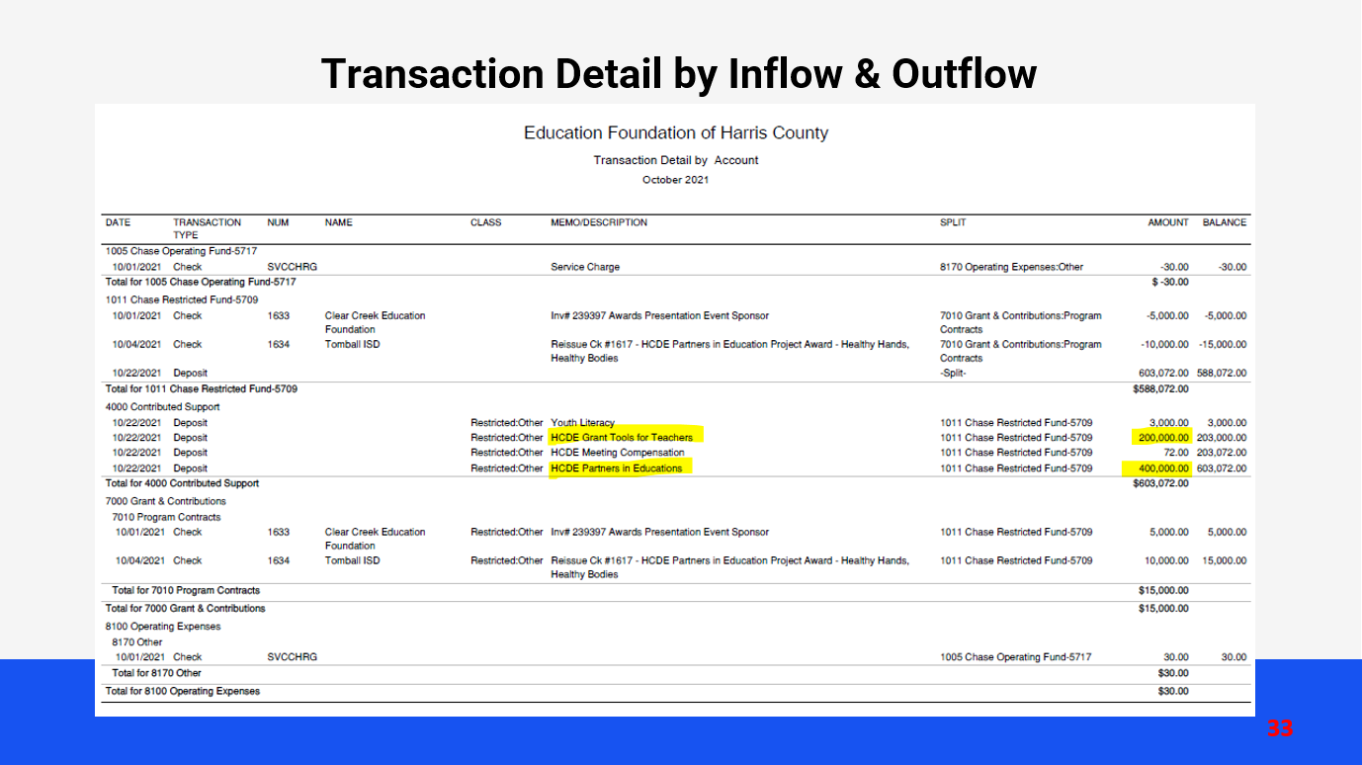






Transaction Detail by Inflow & Outflow
INTERIM FINANCIAL REPORT (unaudited)
TAX COLLECTIONS COMPARATIVE ANALYSIS
Fiscal Year-To-Date as of October 31, 2021
$505 B

Slide 34

PFC & Lease Revenue Projects Update
October 31, 2021

Slide 35



Small Business
Program for construction
Launch industry's first collaboration feature
This is our plan as we launch the industry's first collaboration feature

Slide 36


AB East School Contract $12,358,000 Awarded and Signed
Adult Ed Center Contract $15,121,000 awarded on Oct 2021 Board Mtg
HP East – Projected to award on Nov 2021
Irvington – Pending Architect Assignment
Cash Balance –
Project Acquisition Account
As of October 31, 2021

Slide 37





Income Statement– Project Acquisition Account
As of October 31, 2021

Slide 38


Capital Program Proposal from Aug 3, 2020

Slide 39







2020 Projected Capital Improvement Program
Project | Substantial Completion Date | Project Budget | Maintenance Notes Projected | Revenue Bonds Proceeds | General Funds Use of Fund Bal. | Interest Earnings Projection
Reagan Adm Bldg. | Feb 9, 2023 | $8,365,500 | $ 8,365,500 | N/A | N/A
Adult Ed Building | Oct 25, 2022 | $18,358,750 | $ 3,659,000 | $12,728,598 | $1,870,000 | $101,153
HP East Middle | Oct 25, 2022 | $7,916,645 | $ 1,089,500 | $4,909,645 | $1,870,000 | $47,500
Ab East Campus | Aug 16, 2022 | $17,805,875 | $ 2,759,000 | $12,943,640 | $2,000,000 | 103,235
 | Total | $52,446,770 | $15,873,000 | $30,581,882 | $5,740,000 | $251,888
 |  | Closed on 12-2-20 | Invested in pools.
Build a product accessible on all devices
This is our plan as we build a product accessible on all devices.
Note: The Total Public Notice was $54,000,000. ($35,000,000 for Revenue bonds and $19,000,000 for Maintenance Notes) on August 10, 2020. A transfer of $1,350,000 plus $50,000 in reimbursable expenditures was made from AB East to allocate Program Manager costs to establish the budgets.
Based on Pricing the principal amount will vary due to the premium projected in the bond sale. Revenues Bonds estimated at $27,730,000 and Maintenance Notes for $13,695,000

Slide 40

Other Capital Projects Underway and Projected
Coolwood Head Start Center to be funded by federal grant $9.5M Est.
Funded through a series of HHS Grants - NOGA Land funded, and Construction
Properties closed – Zieben Property and Houston Parks Board
6311 Irvington Property for Workforce Development – Adult Ed
619 King Property projected for Dec Closing.
NOGA received. Due diligence under way for pending property at this time. Schematic design also underway.
Barrett Station and Humble Early Head Start Projects under development $350,000 received from HC Precinct 2

Slide 41



Interim Financial Report (Unaudited)
I certify that the foregoing information is true and accurate to the best of my knowledge.
/s/ Jesus J. Amezcua, RTSBA,CPA, Ph.D., CPFIM, Asst. Supt. for Business Support Services
/s/ Marcia Leiva, Chief Accounting Officer
/s/ Rubi Platero, MBA, Staff Accountant

